Slide 1
Spotify Rest API Project
- Siddharth Chhabra
Under supervision of Mr. Hakan Samci

Slide 2
Contents
Introduction
Softwares used in project
Motivation
Important Note
UML Diagram
Use Case
Sequence Diagram
Login Authentication
Software functionalities

Slide 3






Softwares used in Project
Microsoft SQL Server Management Studio 18
Visual Studio 2022 (Backend - C#, Microsoft EntityFrameworkCore)
Visual Studio Code (Frontend - Angular 14.0.6)
Spotify API (Spotify for developers - https://developer.spotify.com)
Stripe Server (For checking payment)
Used for creation of Class, Sequence and Use case diagrams -https://online.visual-paradigm.com

Slide 4
Motivation
To create an application similar to spotify where user can preview, listen and buy albums of their favorite artists,bands and groups.
Data is extracted from the Spotify API that is provided by spotify developers for public use.
The target audience of this software would be users that are willing to purchase the albums of their favorite artists and listen to their music on our application.
Extra services are provided to users who have registered on our website.

Slide 5
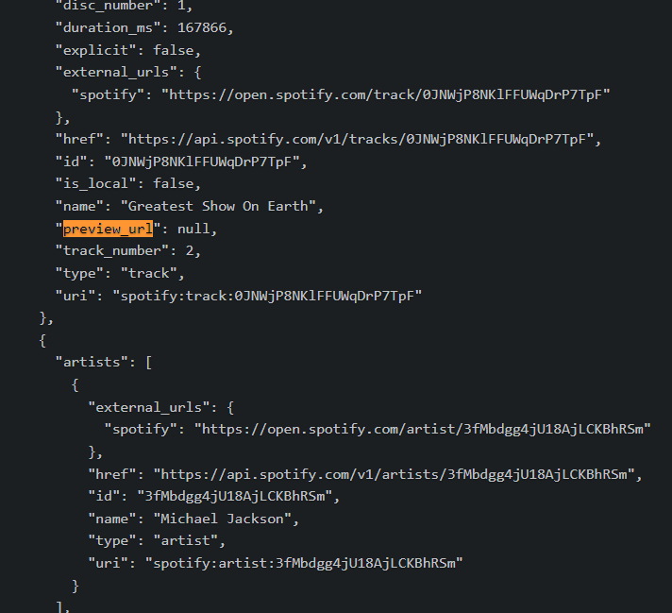
Important Note
The application will provide a preview of tracks for approx. 30 seconds*.
Since complete songs cannot be extracted from spotify API due to licensing reasons it is impossible to play the complete song. So it will be assumed that the albums after successful purchase contain full songs instead of the previews.
Source: Spotify Metadata
* Some of the song preview are not available due to region lock/ accessibility issue or no preview URL is provided by Spotify API itself.

Slide 6
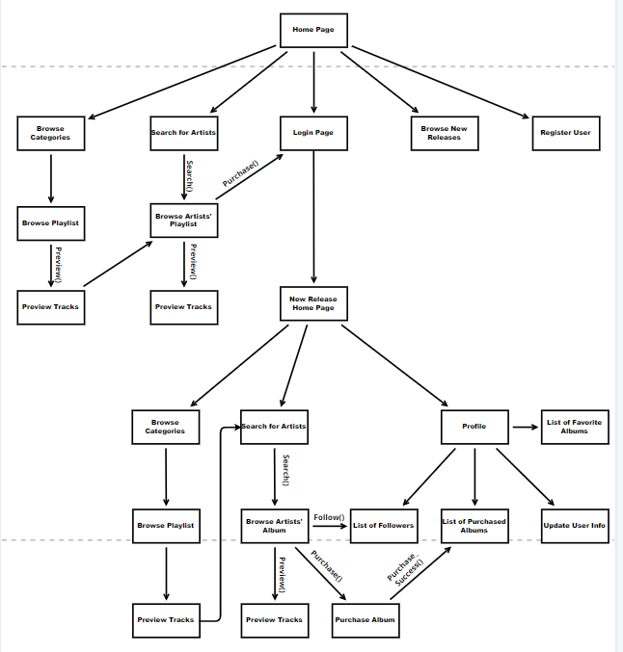
User Interface

Slide 7
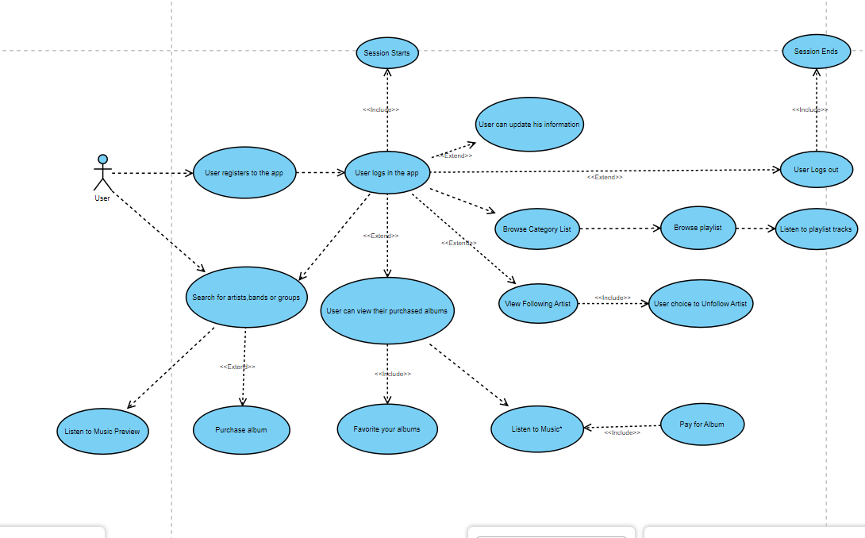
Use Case Diagram (User)

Slide 8
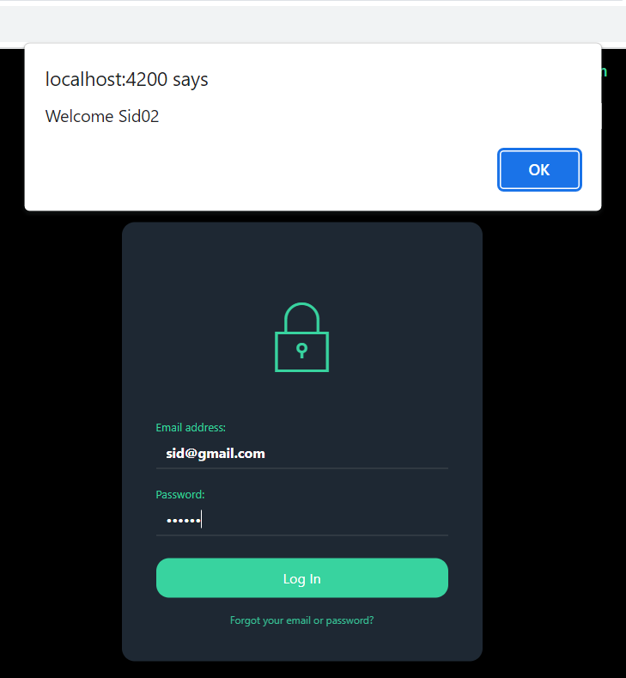
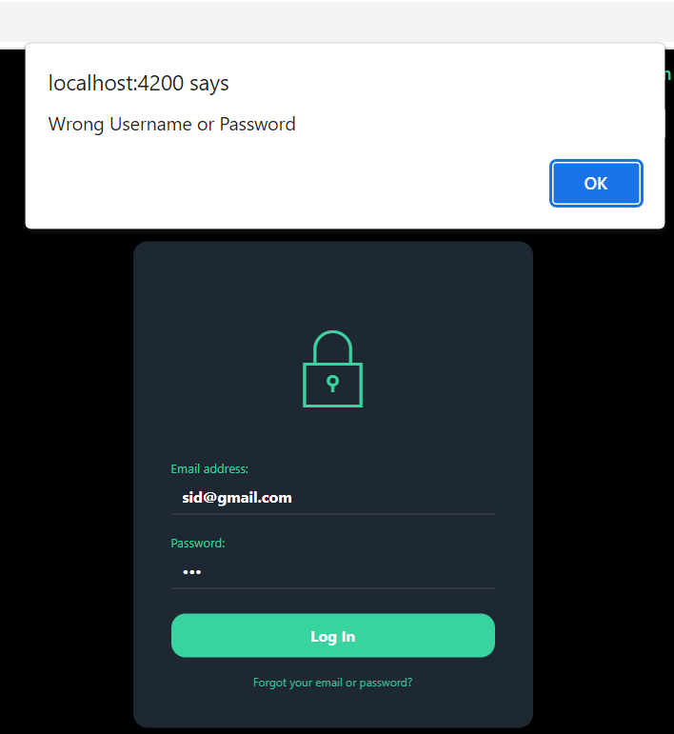
Login Authentication
User enters their email and password.
If the account credentials are successfully validated an alert message will pop up welcoming the user to the service.
JWT token are generated, a session starts and user will be redirected to the new releases page where user can browse the latest music content.
However if invalid email and password were provided as input by the user an alert will pop up with message „Wrong email or password“. No redirects will happen then.

Slide 9
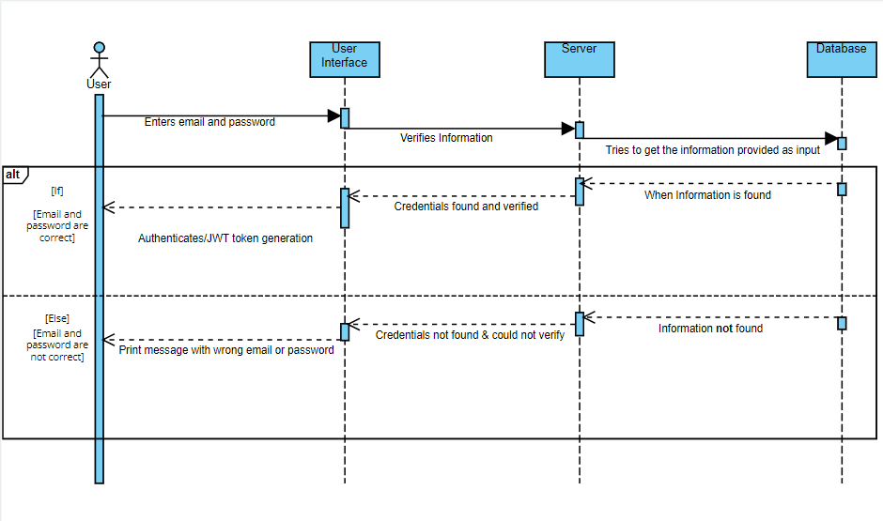
Login Authentication Process via Sequence Diagrams

Slide 10
What can the User do?
The user can preview music without logging in. The preview of the songs lasts for about 30 seconds.
The user can also browse various categories and search playlists related to those category.
Once logged in user can search for their favorite albums and purchase them for 5.00 EUR each.
Users can follow artists, bands and groups and have quick access to the artist webpage.
Users can favorite their purchased albums.
Users can view all their purchased and listen to them anytime.
Users can update their personal information via the update profile page.

Slide 11
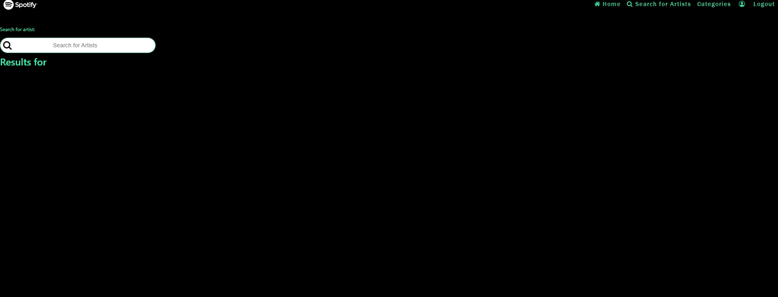
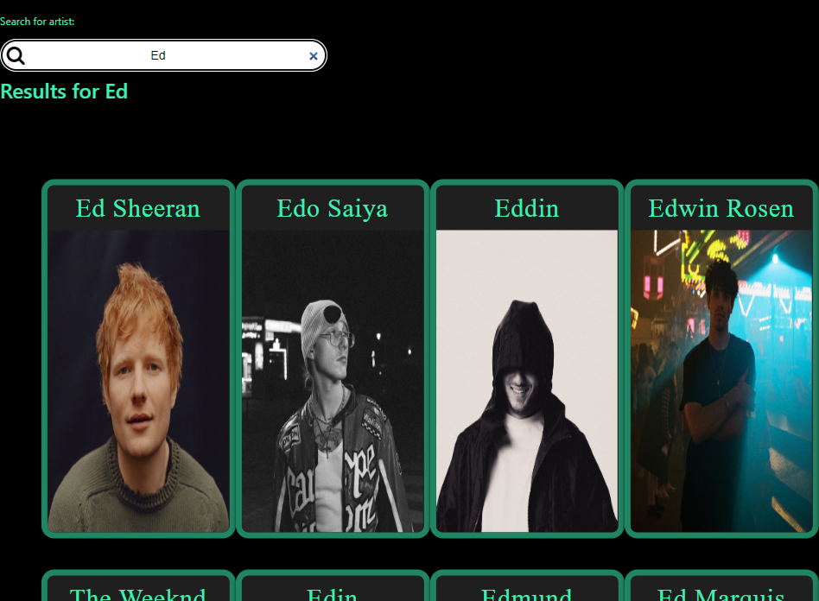
Search Functionality
Search artists,band and groups by typing letters in the search query and it will start showing new relavant results each time a new character is added [Using onkeyup].

Slide 12
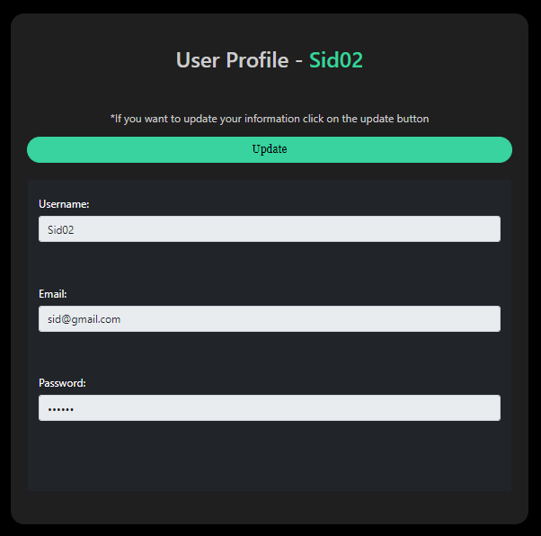
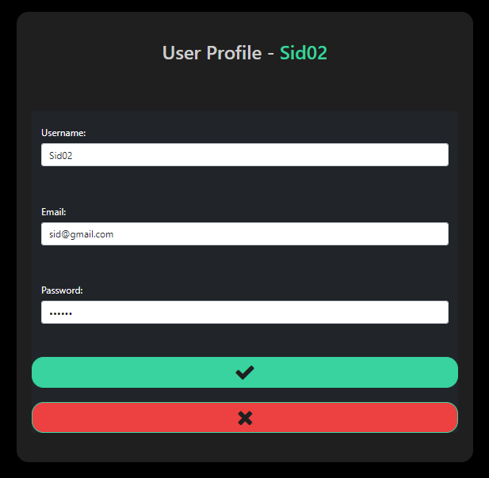
Update User Information Functionality
Before pressing update input fields are disabled and only there for user‘s view
After pressing the update button input fields have been enabled and the user can edit their information.

Slide 13
Payment Functionality + Stripe
Once a user clicks the buy button on the artist‘s album page they will be directed to the payment portal where they will be asked to enter their card information to buy the albums.
Each album is worth 5 EUR each so 5 EUR will be deducted from the user‘s account if a valid card information is being inputted by the user.
If a user enters valid inputs and when the 5 EUR have been deducted they will get a success message and they will be redirected to the purchased albums page where it lists all the purchased albums of the user and the user can then listen to the music.

Slide 14
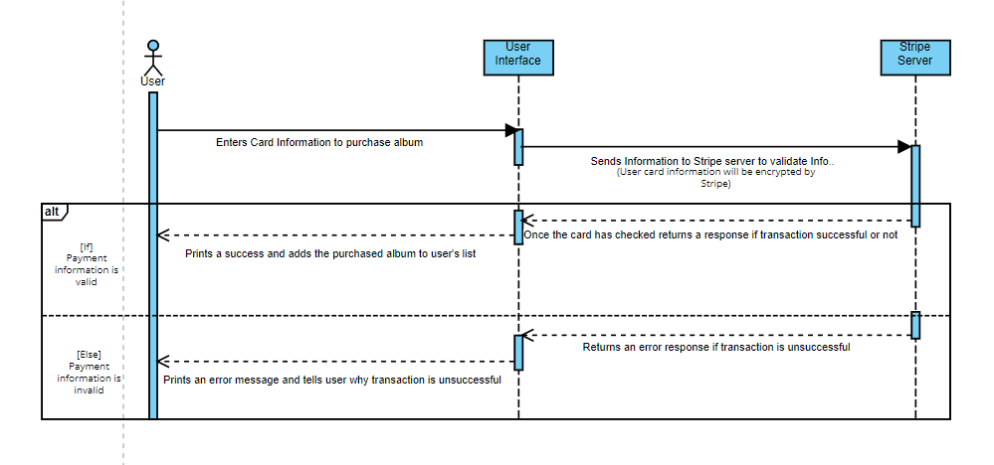
Payment Process via Sequence Diagram

Slide 15
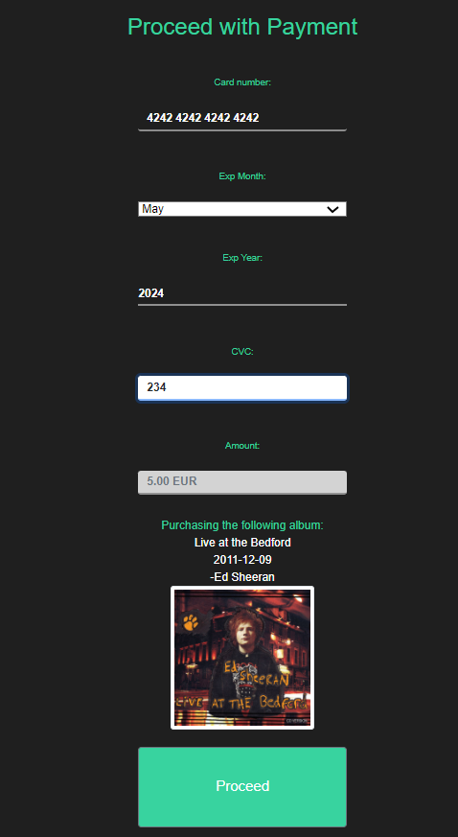
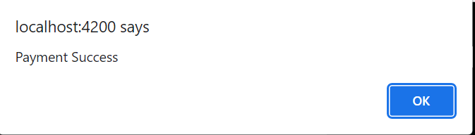
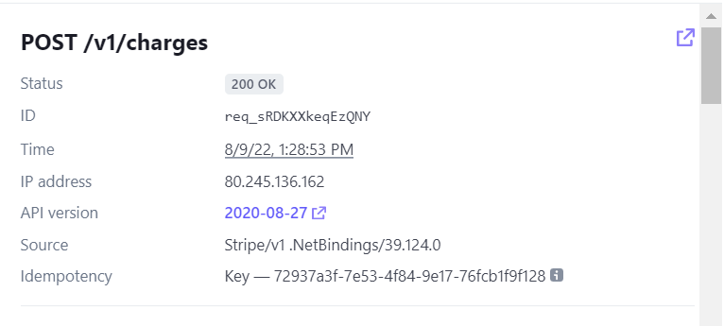
Valid Card Information

Slide 16
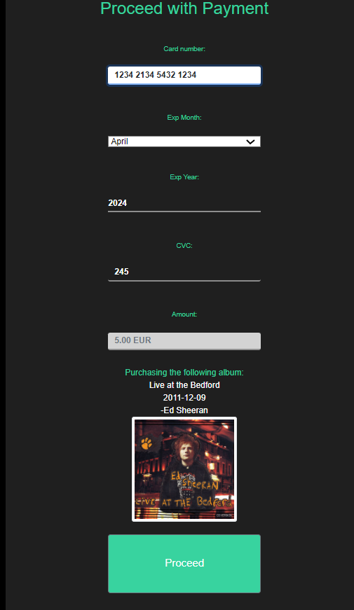
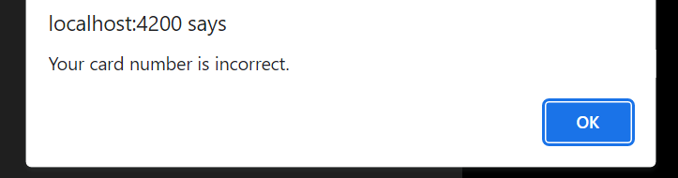
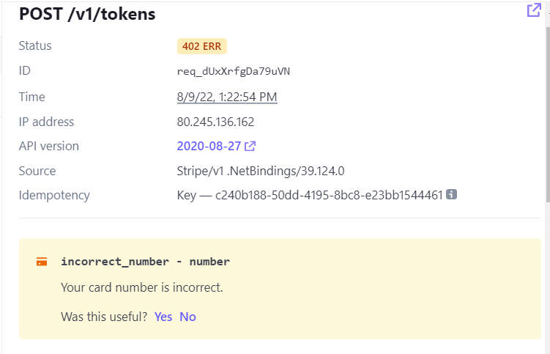
Wrong Card Information
If a user enters wrong information they will be informed that they have inputted the wrong information. Error message is generated from the Stripe server itself.

Slide 17
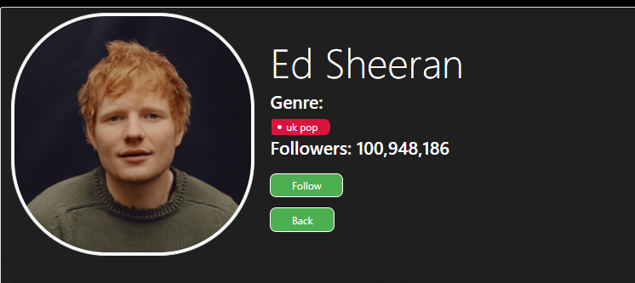
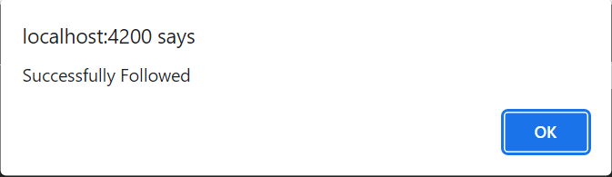
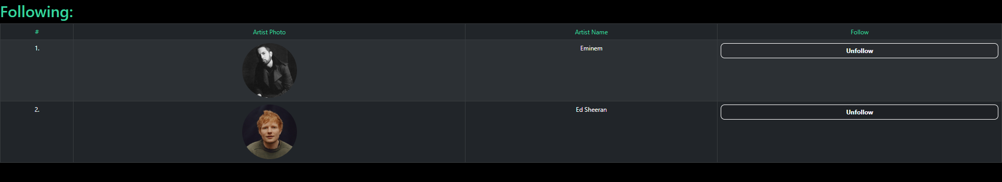
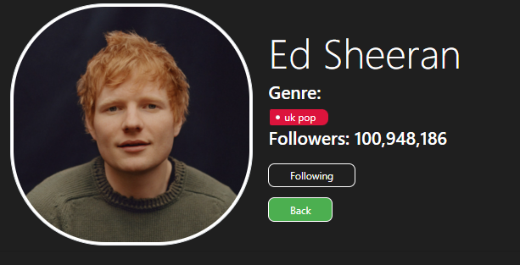
Follow Functionality
Redirects to following page
Shows „Following“ after user follows artist
This functionality allows user to quick access the artist‘s page without having to find it by searching.

Slide 18
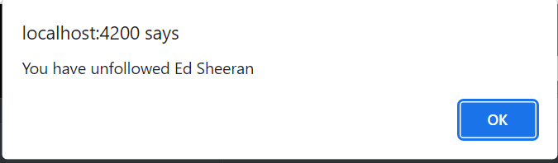
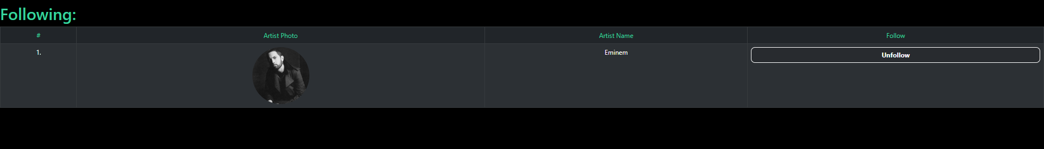
Unfollow Functionality
Pressing Ok will unfollow the artist and reload the page

Slide 19
Favorite Functionality

Slide 20
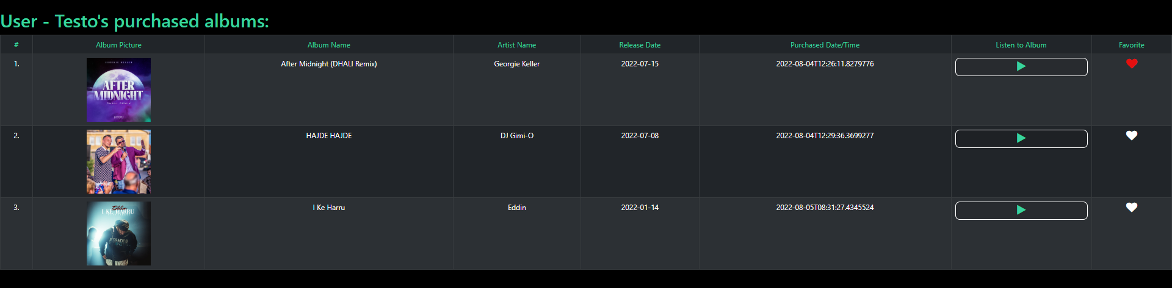
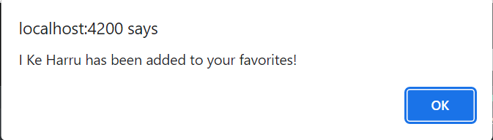
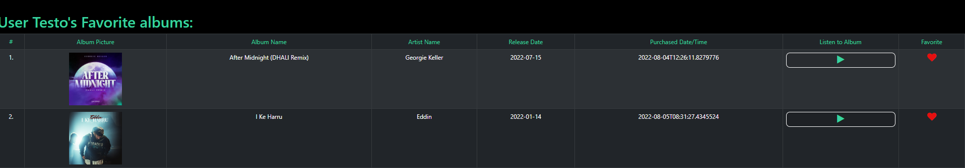
By adding an album to your favorites makes it easy for a user to quickly access

Slide 21
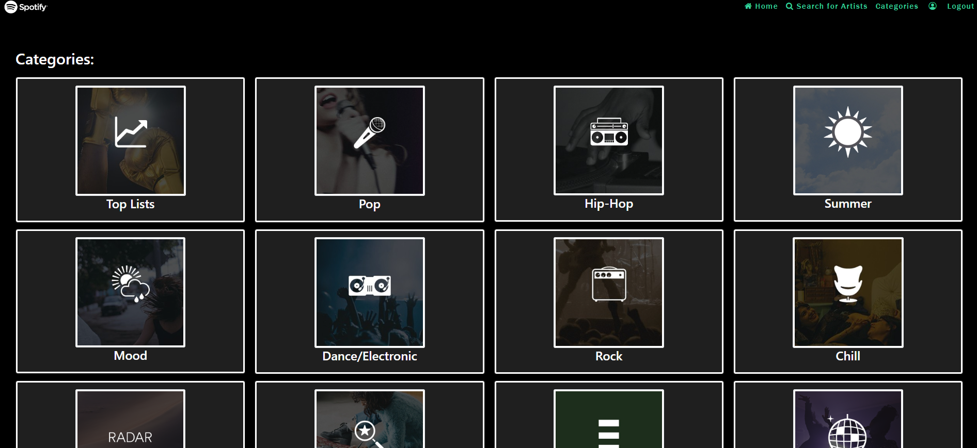
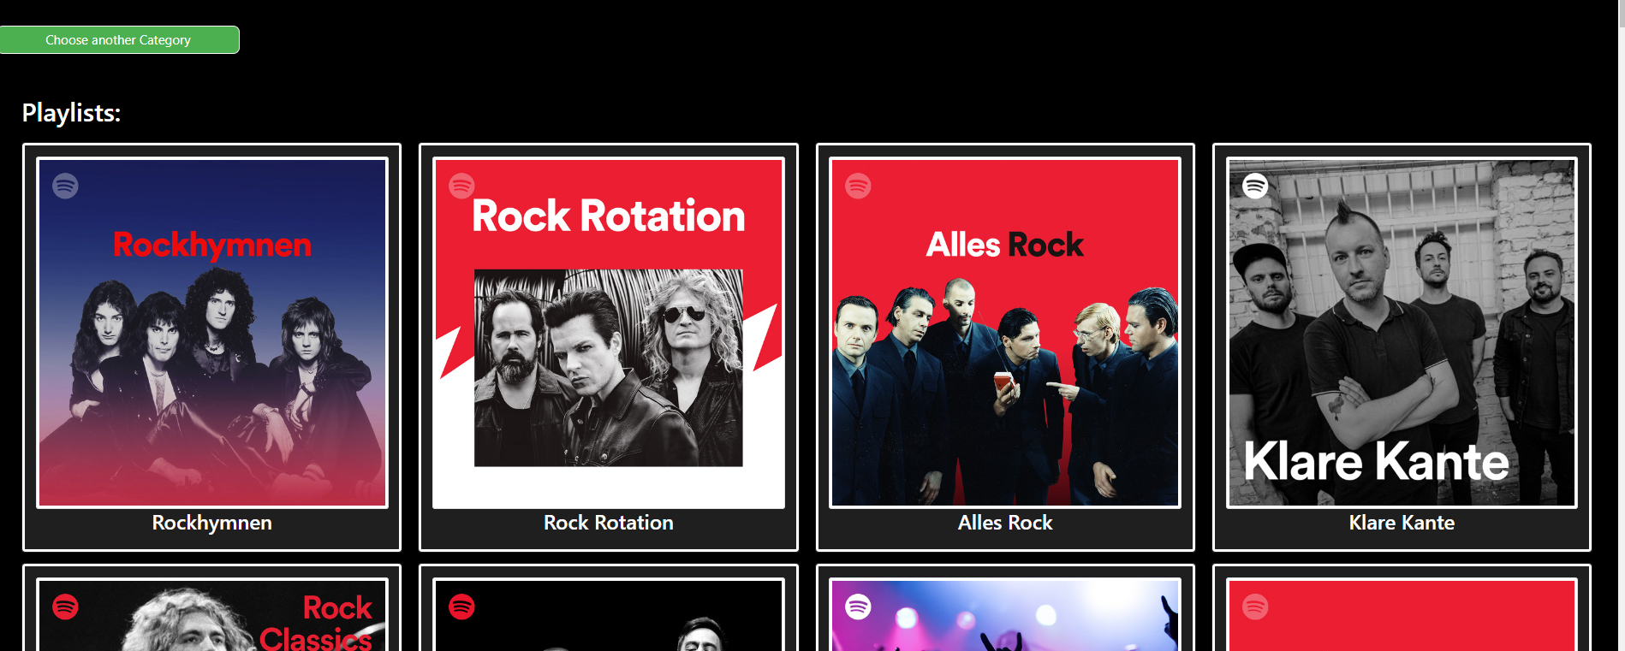
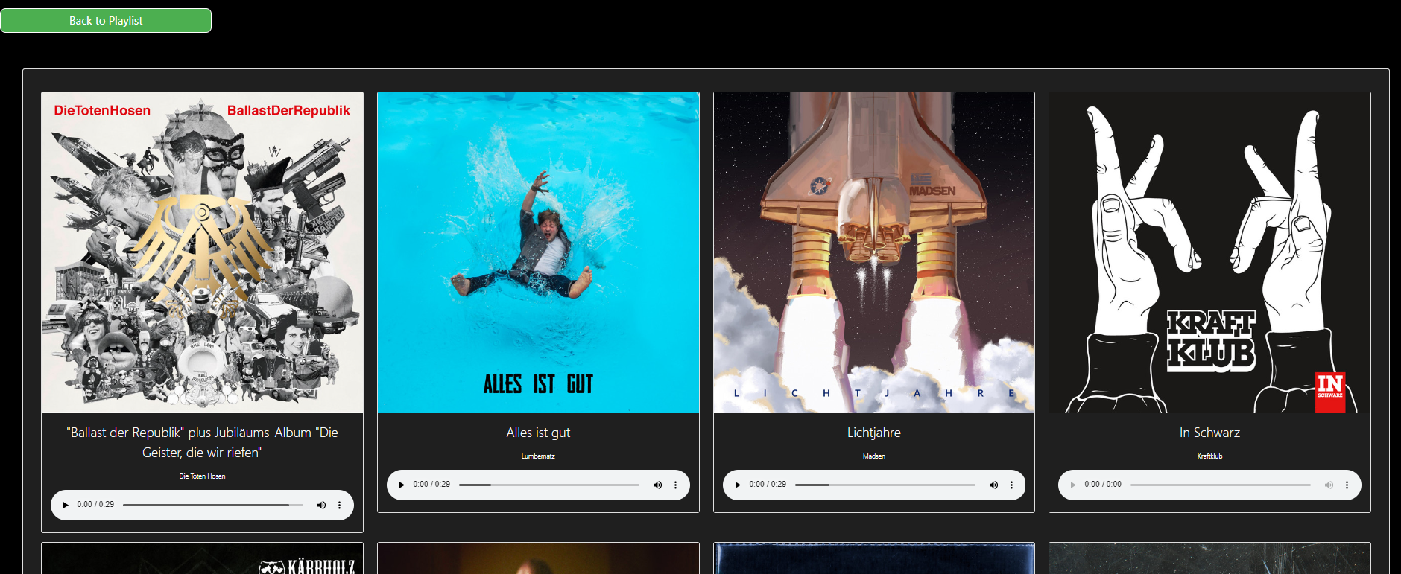
Categories and Playlists Functionality
Each category consists of various albums of that genre.
For example when user clicks on ‚rock‘, the spotify api will provide various playlists contating rocks music.
A user can then click on the playlist and each playlist will consists of tracks with the similar genre.

Slide 22
Thank you! Any Questions?

